Slide 1
Certified Protection Officer Program
Chapter 14
Physical Security Concepts and Applications
Client LOGO
Notes:
Pages 151 -160.

Slide 2
Learning Objectives
Students will be able to:
Define physical security planning.
List the five steps in the security planning process.
List the three options for intrusion monitoring.
Explain the three objectives of security lighting.
Name different types of locking hardware
Provide the three roles of CCTV and access control.
Identify the correct height for security fencing
Explain the fire safe temperature for paper
Explain what convergence is
Conduct a facility tour to explain to the class the physical security measures present.

Slide 3
Purpose
Physical security is a vital part of all security planning and is fundamental to the protection of people, property and assets. Without physical security protection would be difficult or even impossible.

Slide 4
Key Terms
Physical Security Planning
Occurrence Probability Factors
Quantitative Categories
Threat Level Matrix
Layered Security
Glazing
Convergence

Slide 5
Engagement
https://www.youtube.com/watch?v=GxAknTEfC2M
Why is monitoring and intrusion technology more effect than patrolling?
Do you feel it is cost effective?

Slide 6
What is physical security planning
Security process that, if followed, will result in the selection of physical countermeasures based on appropriateness. Countermeasures should also be justifiable from a cost point of view.
The organization identifies its:
Assets,
Risks,
Threats
which then determine the level of appropriate countermeasures that are required based on this process.
Notes:
: 161

Slide 7
Risks
Categorized into three areas:
People
Property
Legal Liability

Slide 8
Security planning process consist of 5 steps
Assets are identified.
People are most important then everything else
2. Loss events are exposed.
Industrial disasters
Natural disasters
Civil disturbance
Crime
Other threats
3. Occurrence probability factors are assigned.
4. Impact of occurrence is assessed.
5. Countermeasures are selected.

Slide 9
Occurrence probability factors are assigned
The following can affect probability:
The physical composition of structures:
wood frame
concrete block
The climatic history of the area, such as:
frequency of tornados
hurricanes
earthquakes

Slide 10
Occurrence probability factors are assigned
The nature of activity at the property to be protected:
if the products being produced are televisions
related products
probability for theft will likely be high
The criminal history for the local and adjacent areas
Is there community conflict in the area

Slide 11
The probability or an occurrence
Certain
Highly probable
Moderately probable
Improbable
Quantitative categories: To make these words more meaningful, we can assign percentage weights to each:
Certain 75 – 100%;
Highly probable 50 – 75%;
Moderately probable 25 – 50%;
Improbable 0 – 25%.
Notes:
: 163

Slide 12
Impact of the occurrence
Very serious
Serious
Moderately serious
Unimportant
These categories should be assigned a financial value.
Notes:
: 163

Slide 13
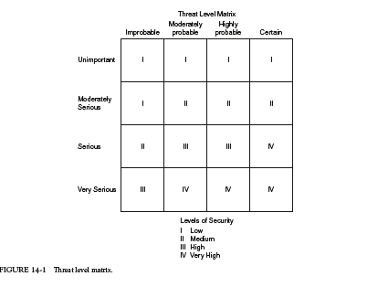
Countermeasure selection Threat Level Matrix
Notes:
: 164

Slide 14
Security-in-depth
Also known as layered security:
A process of placing progressively more more difficult obstacles in the path of the aggressor.
First line of defense:
generally the property line. Can be natural(river), man-made (fence), physical or psychological.
Notes:
: 164-165

Slide 15
Security-in-depth
Second line of defense:
exterior of the building. Remember the building has six sides. Special attention to be given to points of entry.
Third line of defense:
interior controls or object protection.

Slide 16
First line of Defense

Slide 17
Two important points to the systems approach
1. The whole, rather than its individual parts, must be considered.
2. Design should allow for an acceptable level of redundancy, without any unnecessary duplication of effort.
Referred to as system engineering
Notes:
: 165

Slide 18
Security Lighting
Security lighting has three primary objectives:
1. It must act as a deterrent to intruders.
2. It must make detection likely if an intrusion is attempted.
3. It should not unnecessarily expose patrolling personnel.
Notes:
: 166

Slide 19
Four types of lighting systems
Lighting systems are often referred to as:
“ continuous, ”
“standby, ”
“ movable ”
“ emergency. ”
Types of lighting:
Gaseous discharge: street lighting
Metal halide (Gaseous): sports arena type lighting
Incandescent: home lighting.
Quartz: Bright white light.
Notes:
: 166
Most common – mounted on fixed luminaries for night
Lights are only lite when required
Supplemental like an accidents or emergency

Slide 20
Four Application considerations
When designing a protective lighting system, consider three lines of defense:
the perimeter
open yards
building exteriors
2. All accessible exterior lamp enclosures should be in tamper- or vandal-resistive housing. This means that the receptacle and lens should be constructed of a material that will resist damage if attacked and that the mounting screws or bolts should be tamper-resistant.
Notes:
: 167

Slide 21
Application consideration
3. If protective lighting is to be located in an area that may be subject to explosions, the housings should be explosive-resistant.
4. Before finalizing any decision on the installation of lighting, consider the impact that additional lighting will have on your neighbors. Failure to consult with a neighbor prior to an installation may result in costly redesign.

Slide 22
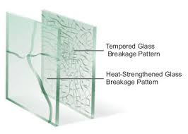
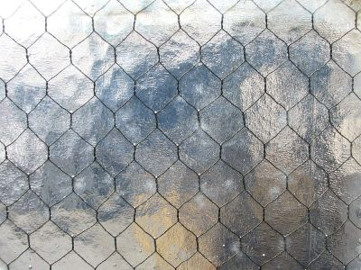
Glazing
Safety/fire:
Tempered: safety glass several times stronger, when it does break, it disintegrates.
Wired: extra strength: for passageways, entrance doors, sliding doors, bathtub enclosures, shower doors.
Notes:
: 167

Slide 23
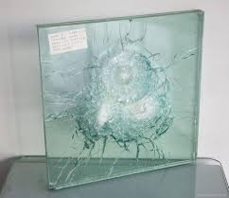
Burglar/vandal-resistive:
Laminated, wired, acrylic, polycarbonate: all much stronger.
Bullet resistive: laminated with glass and polycarbonate: banks
Special purpose: transparent mirror, coated, heated, and rough or patterned: conflict often between lighting and privacy.

Slide 24
Intrusion detection
Every intrusion detection system is meant to detect the following:
1. Unauthorized entry
2. Unauthorized movement within
3. Unauthorized access to controlled areas or objects
There are three components to an intrusion detection system:
1. Detectors/sensors
2. System controls
3. Signal transmission
Notes:
: 168-170

Slide 25
Detectors/sensors
Magnetic switches: door or window contacts
Metallic foil: narrow strip of metal designed to break.
Vibration: shock sensors
Ultrasonic: motion detectors in a enclosed area
Photoelectric: a beam of light reflected

Slide 26
Detectors/sensors
Infrared: area detector: measure radiated energy and ambient temperature
Microwave: high frequency radio waves in a protected area
Dual technology: combines two technologies
Video motion: uses motion sensors and CCTV

Slide 27
System controls/monitoring
System controls includes:
Data Processing Equipment
Signal Transmission Equipment
On/Off
Reset controls
Backup power supply
LED indicators
Equipment specific to particular systems
Notes:
: 170

Slide 28
System controls/monitoring
System monitoring:
1. Local: bell or siren
2. Proprietary: monitored on site
3. Commercial: monitors several sites.
Usually transmitted via phone or internet lines to monitoring site.

Slide 29
Card Access
Magnetic strip encoding
Minimum capabilities:
Restrict access by authorized persons to certain times and/or days of the week.
Allow controlled after-hours access to selected areas within.
Control after-hours access to a parkade.
Selectively control after-hours use of elevators.
Maintain a record of all valid and invalid use of cards.
Provide an audit trail permitting a printout of persons on the property at any one time.
Notes:
: 170

Slide 30
Card Access
There are numerous types of cards:
Magnetic coded: credit card
Magnetic strip coded: credit card
Proximity coded: contactless
Weigand coded: slide through a reader
Hollerith: holes in it
Optical coded: bar code

Slide 31
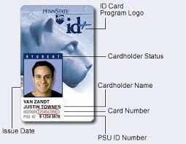
Access control and ID cards
Company name and logo
Details of cardholder
Name
Department
Date of birth
Signature
Photograph
Condition of use (restrictions)
Used widely in government and schools
Notes:
: 171

Slide 32
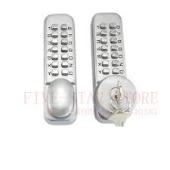
Locking hardware
Locking hardware can be categorized as mechanical, electrical, or electromagnetic, and as either security or non-security.
Quality mechanical security locks should be used for all of the following:
Perimeter openings
Doors that control/restrict internal movement
Doors to sensitive/restricted areas
Only deadbolt locks should be considered. The bolt should offer a minimum of 1-inch throw. If the door is a glass metal-framed door, the bolt should be of the pivotal type to ensure maximum throw.
Notes:
: 171 - 172

Slide 33
CCTV
CCTV has three major roles in any physical security program:
1. To deter crime or unwanted activities
2. To allow the ability to witness an act as it occurs
3. As an investigative tool after an act has already been committed
There are three main views that a standard CCTV system should provide, depending upon the application requirements:
1. Identification of any subjects
2. Identify the actions within a scene
3. Identify the scene where the act occurred
Notes:
: 173

Slide 34
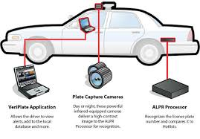
CCTV FEATURES
Video motion detection
People counting and tracking
Object classification
License plate recognition
Facial Recognition
Crowd Detection
Psychology of motion
https://www.youtube.com/watch?v=GhzRiIx6Qxw
https://www.youtube.com/watch?v=NuYDtonfmUA

Slide 35
Components of a CCTV system
Cameras
CCD – Charged coupled device
CMCS – Complementary metal oxide semiconductor
Lenses
Fixed
Varifocal
Zoom - https://www.youtube.com/watch?v=8LwwnoaSB5U
Housings
Monitors
Notes:
: 174

Slide 36
Components of a CCTV system
Sequential switches
Review multiple cameras on one monitor
Motion detectors
Pan/tilt/zoom features
Controls
Consoles
Video recorders
Day/time generators

Slide 37
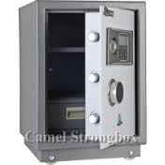
Safes and Vaults
Provide levels of protection against: burglary, robbery and fire.
Burglary resistive safes:
Locks: single comb, single key lock combination and dual combination
Interiors: various types of shelving depending upon the asset.
Depository: allow deposit without giving access to the interior
Time locks: specific time frames.
Time Delay locks: even after using combination, still must wait
Relocking devices: back up features
Extra weight: should be a minimum of 340 kg or 750 lbs.
Floor anchoring: bolt to the floor.
https://www.youtube.com/watch?v=8LwwnoaSB5U
Notes:
: 175

Slide 38
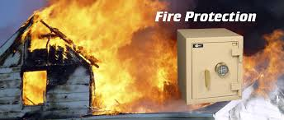
Fire Resistant
Burglary resistive vaults: if a person can enter it, then it is a vault. Reinforced on all 6 sides.
Fire resistive containers: insulated safes, filing cabinets, record containers all offer varying degrees of protection from heat. Note they are not burglary resistive as they are made out of different material.
Paper up to 350 degrees
Tapes and disc 150 degrees

Slide 39
Fencing Rules
History
800 BC – City of Pompeii
Great Wall of China:1368-1644
Barbed Wire: 1867
Chain Link: 1800 in the UK
1. Minimum of 7 feet in height excluding top overhang.
2. 9-gauge or heavier.
3. Mesh openings must not be larger than 2” square inches.
4. Fabric must be fastened securely to rigid metal or reinforced concrete posts set in concrete.
5. No more than 2 inches between the bottom of the fence and the ground.
6. Fabric extend below the surface.
Notes:
: 178 - 179

Slide 40
Fencing Rules
7. Top overhang should face outward and upward at a 45-degree angle.
8. Overhang supporting arms should be firmly affixed to the top of the fence posts.
9. Overhang should increase the overall height of the fence by 1 foot.
10. Three strands of barbed wire, spaced 6 inches apart, should be installed on the supporting arms.
11. A clear zone of 20 feet or more should exist between the perimeter and exterior structures.
12. Where possible, a clear zone of 50 feet or more should exist between the perimeter barrier and structures within the protected area.
Notes:
: 178 - 179

Slide 41
Fencing
First and foremost a barrier
Only a delay system
Supplement with sensors, detectors or CCTV

Slide 42
Convergence
The meshing of physical security, logical security, information technology, risk management, and business continuity into a seamless and integrated system and process.

Slide 43
Education
Career planning
Employers are searching for dedicated security officers
Work exposure is critical
Professional designations
ASIS
IFPO

Slide 44
Closure
Define physical security planning.
List the five steps in the security planning process.
List the three options for intrusion monitoring.
Explain the three objectives of security lighting.
Name different types of locking hardware
Provide the three roles of CCTV and access control.
Identify the correct height for security fencing
Explain the fire safe temperature for paper
Explain what convergence is
Conduct a facility tour to explain to the class the physical security measures present.

Slide 45
Class assignment
Students are to go out in groups and make a detailed list of all the physical security measures in place at the training facility. You have 45 minutes to complete the assignment.
Items needed:
Clip Board
CPTED Assessment
Writing tool

Slide 46
Review
What are the five steps in the security planning process?
1. Assets are identified.
2. Loss events are exposed.
Industrial disasters
Natural disasters
Civil disturbance
Crime
Other threats
3. Occurrence probability factors are assigned.
4. Impact of occurrence is assessed.
5. Countermeasures are selected.

Slide 47
Review
What are the three options for intrusion monitoring?
Every intrusion detection system is meant to detect the following:
1. Unauthorized entry
2. Unauthorized movement within
3. Unauthorized access to controlled areas or objects
There are three components to an intrusion detection system:
1. Detectors/sensors
2. System controls
3. Signal transmission

Slide 48
Review
What are the three objectives of security lighting?
Security lighting has three primary objectives:
1. It must act as a deterrent to intruders.
2. It must make detection likely if an intrusion is attempted.
3. It should not unnecessarily expose patrolling personnel.

Slide 49
Review
What are the three roles of CCTV and access control?
CCTV has three major roles in any physical security program:
1. To deter crime or unwanted activities
2. To allow the ability to witness an act as it occurs
3. As an investigative tool after an act has already been committed
Every intrusion detection system is meant to detect:
1. Unauthorized entry
2. Unauthorized movement within
3. Unauthorized access to controlled areas or objects

Slide 50
Questions?
Review for the quiz

